Slide 1
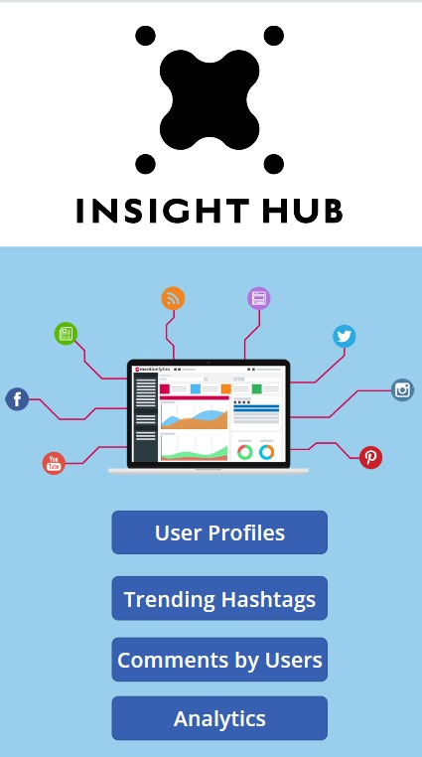
Team insight hub
Social Media Insights and Analytics
- Saarthak Joshi & Divyanshu Srivastava

Slide 2
IDEA/Inspiration BEHIND THE PROJECT
By assessing user engagement based on location and content types, the project enhances brand outreach. It also identifies trending hashtags to guide content creation for increased resonance with the target audience and heightened online visibility.
Social media platforms have become central hubs for users to share their experiences, and preferences, and engage with diverse content. Understanding and leveraging these user interactions can provide businesses valuable insights based on:-
User Engagement Analysis by Geographic Location.
Content Type Analysis (Posts and Videos).
Trending Hashtags Analysis.

Slide 3
DATASETS AND TABLES SELECTION PROCESS
We generated datasets for the construction and selection process using Mockaroo, tailoring it to meet specific requirements.
Utilizing the mock data, we constructed tables relevant to the project's needs and inserted the generated data into these tables.
This approach allows us to simulate a realistic environment for analysis, ensuring that the dataset aligns with the parameters and criteria outlined for the construction and selection process.

Slide 4
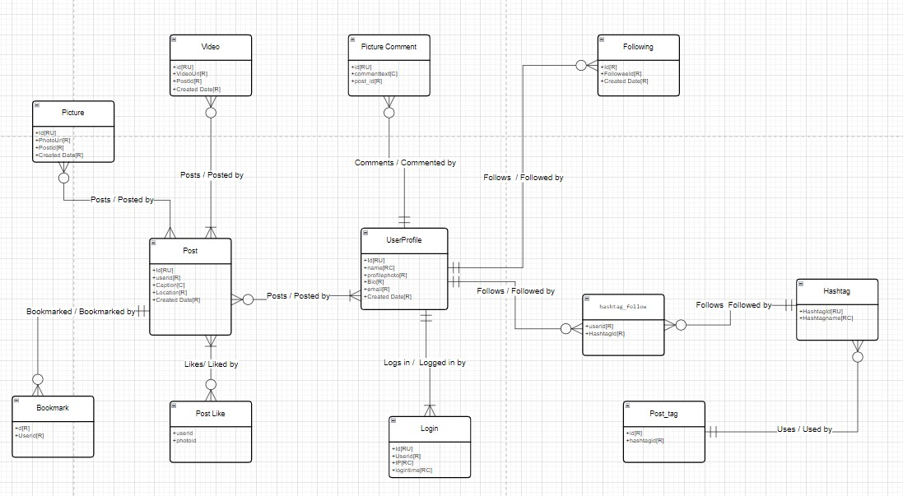
Conceptual and Logical Modelling Ideology

Slide 5
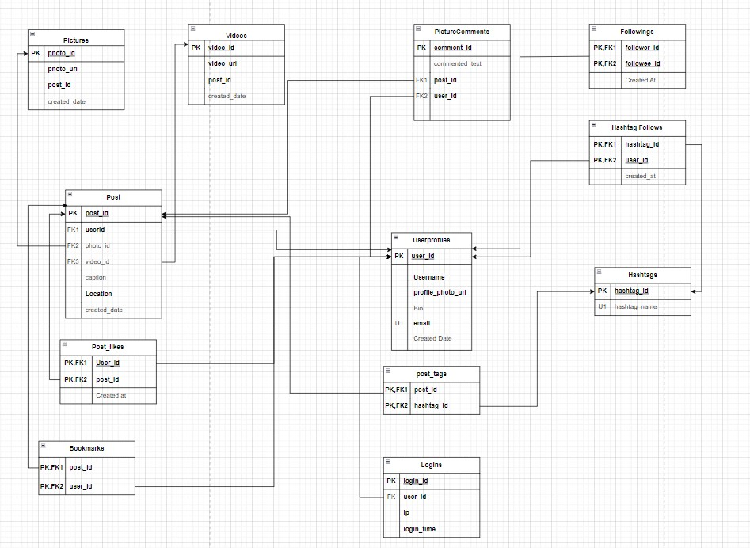

Slide 6
Area of Improvements
While the social media analytics project appears comprehensive and well-structured, there are always areas for potential improvement. Here are a few suggestions for areas of enhancement:
Real-time Data Integration.
Sentiment Analysis.
Data Security Measures.
In-depth User Segmentation.
Dynamic Hashtag Recommendations.
User Feedback Integration.

Slide 7
Project Demo
https://video.syr.edu/media/t/1_ae5q7h4z

Slide 8
Challenges Faced
Reached Azure credits maximum limit 2 days before the deadline.
Setting up Azure Services to facilitate connection between server and database.
Embedding PowerBI interactive dashboards into MS PowerApps.

